Slide 1
AWS - Lightsail

Slide 2
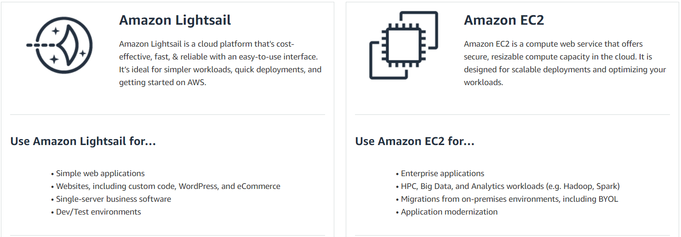

Slide 3
Introduction
Amazon Light sail is an easy way for developers to get started with a simple virtual private server (VPS) solution.
Lightsail provides compute, storage and networking capacity and capabilities to deploy and manage websites and web applications in the cloud.
Lightsail includes everything you need to launch your project quickly – a Virtual Machine, SSD storage, DNS management, static IP, data transfer etc.

Slide 4
Best suited to projects that require a few virtual private servers and users who prefer simple management interface.
Common use cases : launching websites, blogs, web applications, simple software etc
Offers a range of OS flavors (windows, Linux flavors), application templates that gets automatically created whenever new lightsail instance is created. Application instances include Wordpress, Drupal, Joomla etc
Plan includes a virtual server with a fixed amount of memory (RAM), compute (vCPUs) etc..
It also offers static IP address (5 per account), DNS management (3 domain zones per account). Plans are charged hourly, on-demand basis so we pay only when we are using it.

Slide 5
Everything we do in Lightsail console can be done using an API call.
Each Lightsail instance automatically gets a private IP address and a public IP address, which are reachable from the internet.
You can use the private IP to send data to other Lightsail instances and AWS resources in private for free.
Everytime we reboot the Lightsail instance the public IP address changes. To maintain it constant we can use static IP address.

Slide 6
Registering domain names
We can map our registered domain names to the public Ips of our Lightsail instances.
To use a domain in Lightsail we must first register it. This can be done using Route53.
Snapshots can be used to backup our data within Lightsail. These snapshots can be used to create new Lightsail instance.
Each Lightsail plan comes with a free data transfer allowance.

Slide 7
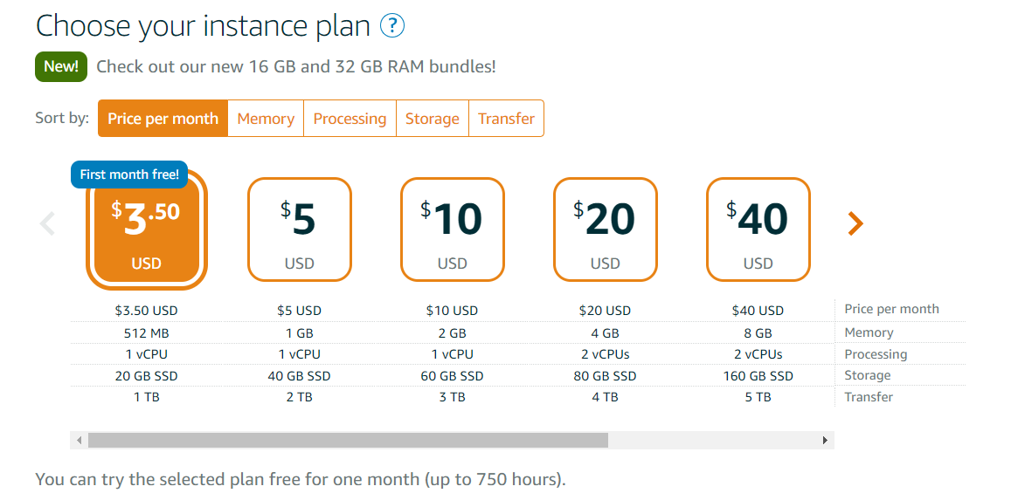

Slide 8
For the data transfer into the instance is always free but data transfer going out to internet (outbound traffic) is costly.
If two lightsail instances need to talk (transfer data) between each other then it will be totally free (provided that they are in same aws account).
If there is a need for communication from s3 lets say to lightsail, that will be free too

Slide 9
By default Lightsail instance gets launched with a public IP but if we want we can assign static IP as well.
Public IP changes whenever instance reboots but static will not
By default there is a private IP to the instance as well
If we want to upgrade or migrate or even at regular intervals if needed we can take snapshots for the instances of Lightsail.
If your instance is deleted then you are not charged but if we stop the instance even then we are charged as the data is still available.

